Slide 1
StringTheory User Testing Chord Tutorial
Paul Treanor and Colin Gorman

Slide 2
Welcome!

Slide 3
What is this tutorial for?
The goal of this tutorial is to show you how to play a few basic chords.
From here you will be able to compare practicing these chords on the StringTheory app to practicing them on a regular guitar.
Your feedback is important to us because it can help us improve the app.

Slide 4
The plan
Learn to play a simple series of chords on guitar
Play the same chords on the app
Play the chords on the guitar again to see if you improved

Slide 5
Time to start learning!

Slide 6

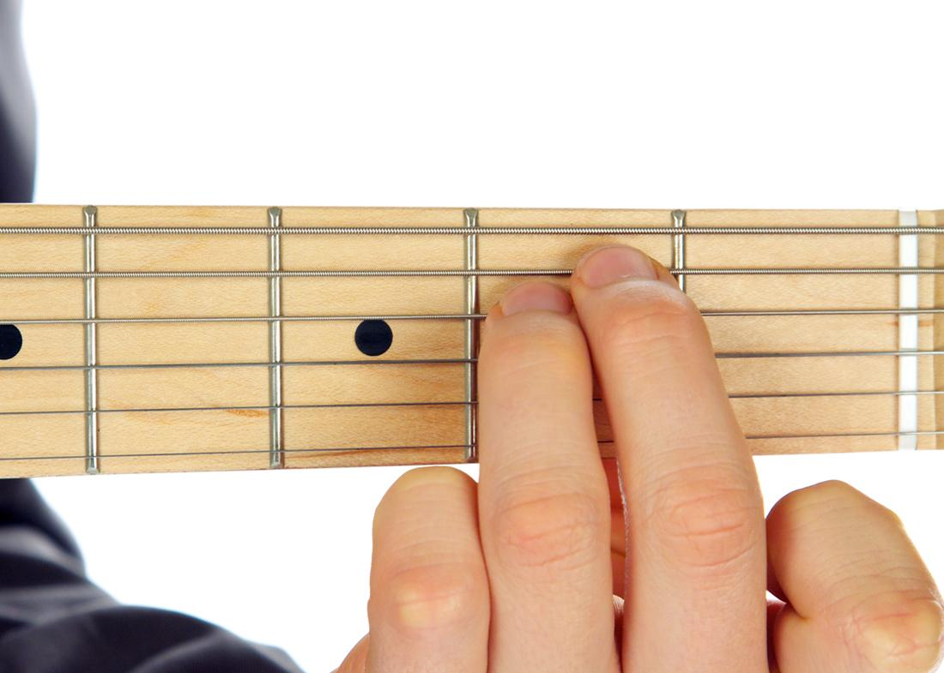
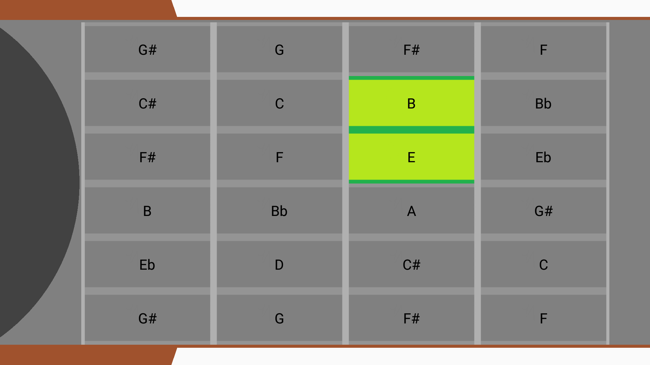
The first chord - Em
Press down these notes:

Slide 7
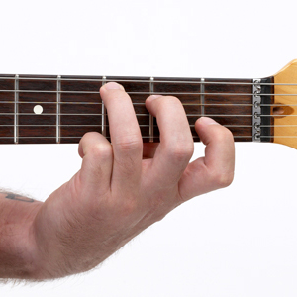
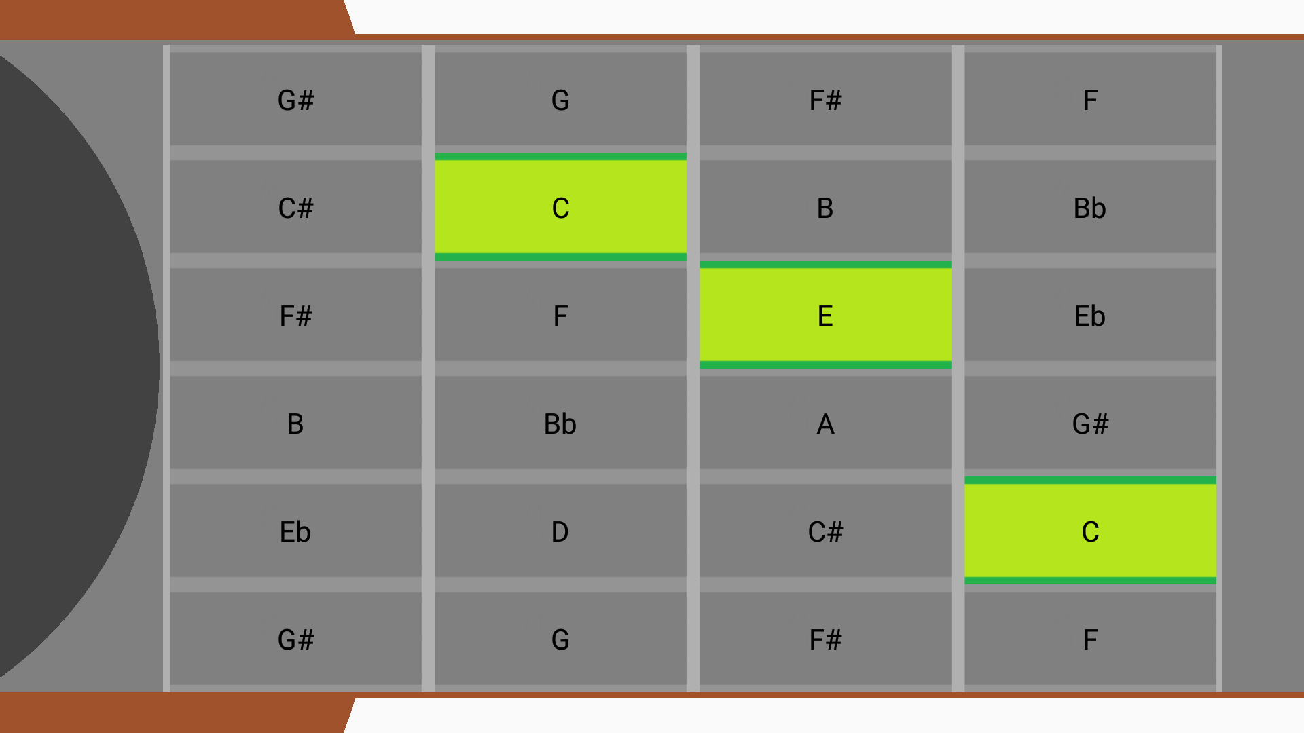
The 2nd Chord - C
Press down the notes as shown:

Slide 8
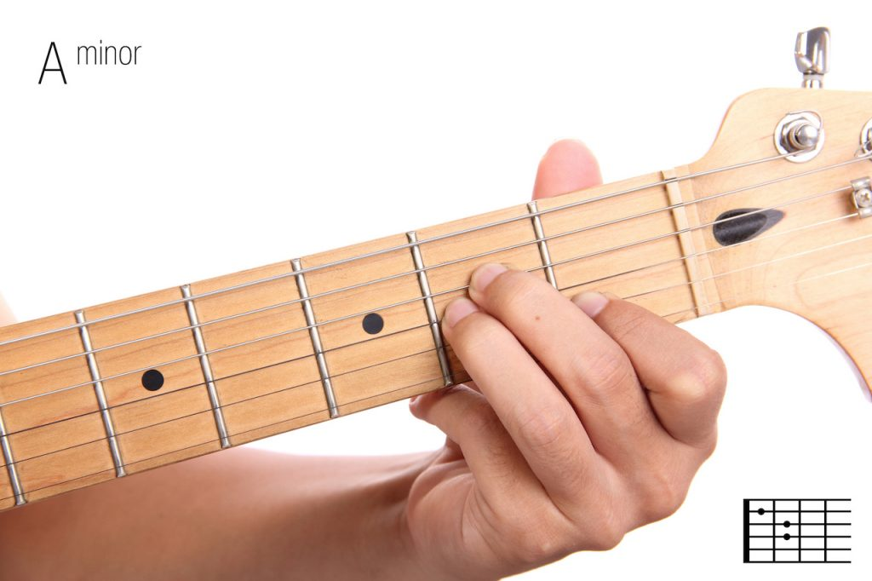
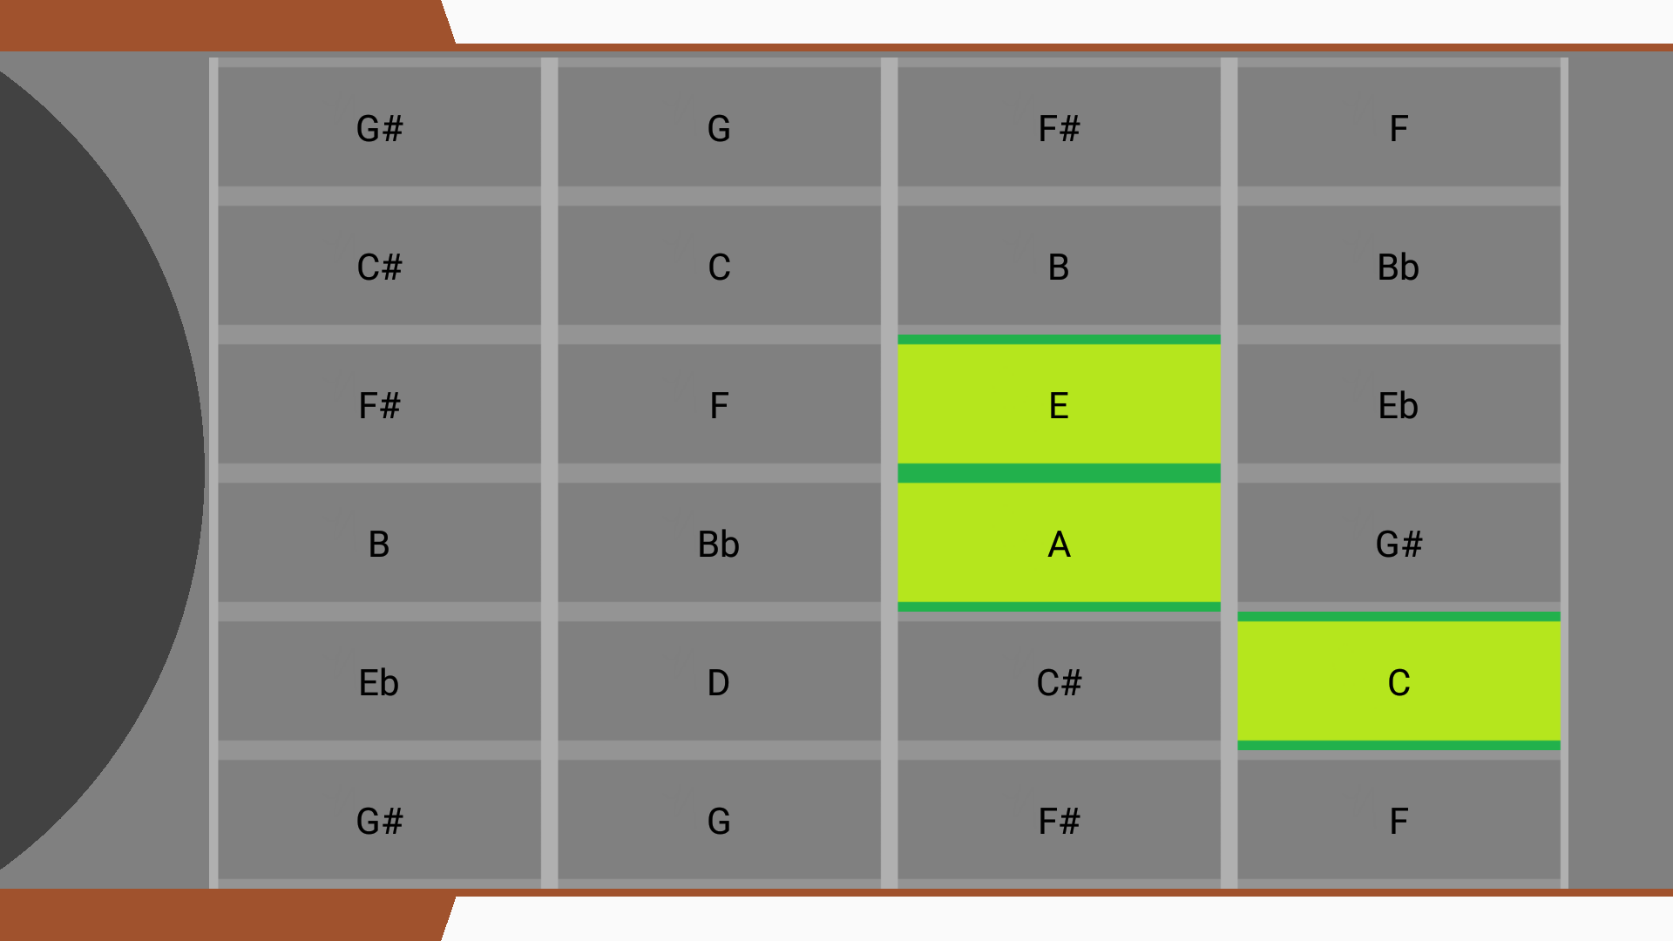
The final chord - Am
Play the notes that are shown:

Slide 9
Now let’s play the chords as a series
1
2
3
4
Em
C
Am
C (again)

Slide 10
Thanks for taking part in our research!

